Slide 1
What is PF Debate?

Slide 2
A simple definition
PF is a relatively new debate format that emphasizes persuasive speaking and real world argumentation.
In Public Forum, there are two sides: pro and con. The pro is sometimes referred to as the “aff,” short for “affirmative,” and the con is sometimes referred to as the “neg,” short for “negative.”

Slide 3
And More definition
The “resolution” is the topic for the debate. The pro side will uphold & defend the resolution, while the con side will come up with reasons why the resolution is a bad idea.
There are two teams in a round, and each team is comprised of two debaters. After the round, a judge will award the victory to one side, and will assign speaker points to all debaters in accordance with how well they presented themselves.

Slide 4
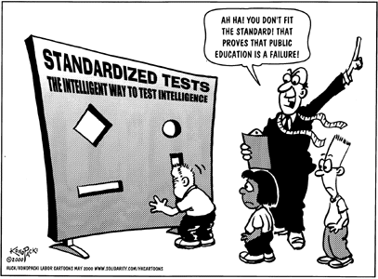
PF Resolutions
On balance, standardized testing is beneficial to K-12 education in the United States

Slide 5
The Organization of an PF Round 1
Teams flip for who speaks first, AFF or NEG
Team 1 Constructive (delivered by 1st speaker of team): 4:00 minutes
Team 2 Constructive (delivered by the 1st speaker of team 2): 4:00 minutes
1st speaker crossfire (exclusively for 1st speakers to ask question to each other): 3:00 minutes
Team 1 Rebuttal (delivered by 2nd speaker of team 1 to refute the other team’s points): 4:00 minutes
Team 2 Rebuttal (delivered by 2nd speaker of team 2 to refute the other team’s points): 4:00 minutes
2nd speaker crossfire (exclusively for 2nd speakers to ask question to each other): 3:00 minutes

Slide 6
Organization of a PF round - 2
Team 1 Summary (delivered by 1st speaker of team 1 ) 2:00 minutes
Team 2 Summary (delivered by 1st speaker of team 2 to refute opponents point but mainly to protect their own): 2:00 minutes
Grand crossfire (everyone is involved asking questions to anyone): 3:00 minutes
Team 1 Final Focus (delivered by 2nd speaker of team 1 ): 2:00 minutes
Team 2 Final Focus (delivered by 2nd speaker of team 2 ): 2:00 minutes
Each team has 2 minutes of prep time to be used anytime in the round. You do not have to use this all at once.

Slide 7
how a PF case is organized:Introductions
Introductions to debate cases should be like an introduction to an essay: they should grab the judge’s attention and show why your arguments are important.
Introductions are best used in debates with lay judges. They prepare the judge to accept your arguments. However, if you’re debating in front of an experienced judges, you should/can minimize the introduction.

Slide 8
how a PF case is organized: Definitions
you’ll need to decide whether the words of the resolution need to be defined. Are there any words you see as being debatable? Are there certain definitions that, if accepted, would derail your case?
See here: “Resolved: In order to better respond to international conflicts, the United States should significantly increase its military spending.”
Do you see a term that will need more definition?
“significantly increase” will require some definition .

Slide 9
how a PF case is organized: Observations
Observations are assumptions or points you’d like to make about the resolution.
You should only read them if you think that they will help your case, otherwise they are wasting time that you should use to make arguments.
The resolution on the previous slide could lead you to observe that the US’s possession of offensive weapons is presumed by the wording. We are debating how much to increase the capacity to have and use such weapons. .

Slide 10
how a PF case is organized: Framework
Framework is a way for the judge to weigh the debate.
The default framework in PF is utilitarianism i.e. the judge votes for the team that causes the most net good. You are presenting the judge reasons to believe that your side does more good than your opponents.
If you want the debate to be judged under a utilitarian framework, then you don’t need a framework section.

Slide 11
how a PF case is organized: Conclusion
A conclusion allows you to wrap up your case in a pretty bow and tell the judge why they’re voting for you.
You should summarize your strongest points.
You can use/recall some powerful wording from the introduction here as well.

Slide 12
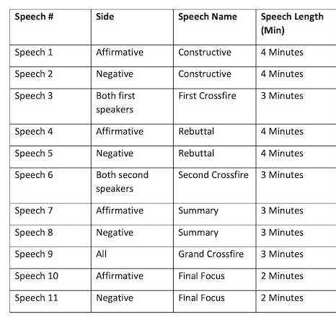
Times and Speeches

