Slide 1
What is LD Debate?

Slide 2
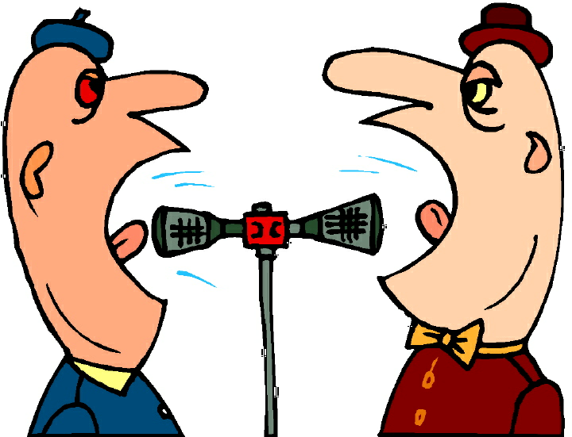
First it is Debate
But NOT THIS !

Slide 3
A simple definition
Lincoln-Douglas is a one-on-one debate event between two opponets, as contrasted with Public Forum and Policy which are two-on-two. In Lincoln-Douglas, the opponets will debate an assigned topic and attempt to persuade the judge that they better upheld their side of the resolution. The two sides are called the Affirmative (Aff) and the Negative (Neg) . The resolutions in LD debate are about we should value most in a given situation. See the next slide for an example.

Slide 4
LD Resolutions
A government has the obligation to lessen the economic gap between its rich and poor citizens

Slide 5
The Organization of an LD Round
Affirmative Constructive- 6 minutes
Negative Cross Examination of Affirmative- 3 minutes
Negative Constructive- 7 minutes
Affirmative Cross Examination of Negative- 3 minutes
First Affirmative Rebuttal- 4 minutes
Negative Rebuttal- 6 minutes
Second Affirmative Rebuttal- 3 minutes
Throughout the debate, each speaker will have a specified amount of preparation time, usually 4 minutes.

Slide 6
how an ld case is organized
1. Opening
2. statement of the resolution
3. Value
4. Value Criterion (standard)
5. Definitions
6. (Optional) observations
7. Contentions and subpoints
8. Summation and closing

Slide 7
how an ld case is organized:Introduction
The first part of your case should contain a short introduction. This can come in the form of a quotation or a statistic framing your side of the resolution.
A. After this, you should state your side and the resolution.
I. “It is because I agree with [author of your quote] that I affirm the resolution,
Resolved:…”
The use of a quotation or stat is not favored by all coaches – If you don’t use one, start with the resolution.

Slide 8
how an ld case is organized: framework
In the framework, you should establish the burdens of each debater, as well as set up your value and criterion.
A. The value is the highest thing that you seek to achieve when affirming or negating.
Values can be a number of things, but the most common ones are justice, morality, and societal
welfare.

Slide 9
how an ld case is organized: framework 2
The value criterion is the mechanism that you use to achieve your value.
So, if your value is justice, and your value criterion is maximization of rights, your conception of justice is one that says whomever protects the most amount of rights achieves justice and should win.
Within this part of the case, you must provide arguments as to why your criterion should be preferred over any other criterion.

Slide 10
how an ld case is organized: Contentions
These are the parts of your case that are going to formulate arguments justifying your side of the resolution
Contention One: Here you should have a sentence briefly explaining the overall argument your contention will make.
Sub-point A: Your contention may have multiple justifications for its conclusion, so you should separate each justification into sub-points so that it creates an easy way for people to follow your arguments.
Within this sub-point you should have a claim, warrant (typically evidence), and an impact.
Repeat this process for as many contentions as you have. Cases often have anywhere from 1 to 3 contentions.

Slide 11
how an ld case is organized:Conclusion
The conclusion isn’t crucial, but many judges like to see at least a sentence at the end of your case essentially summarizing your position.
You will find that many debaters end their speeches with, “For these reasons I would ask you to vote affirmative/negative in this debate.”

Slide 12
Time (minutes) | Abbreviation | Speech | Description
6 | AC | Affirmative Constructive | The Affirmative (always) reads a pre-written case.
3 | CX | Cross Examination | The Negative asks the Affirmative questions.
7 | NC (1NR) | Negative Constructive (and first negative Rebuttal) | The Negative (almost always) reads a pre-written case and (almost always) moves on to address the Affirmative case.
3 | CX | Cross Examination | The Affirmative asks the Negative questions.
4 | 1AR | First Affirmative Rebuttal | The Affirmative addresses both their opponent's case and their own. This speech is considered by many debaters to be the most difficult speech, as debaters must use 4 minutes to respond to a 7-minute speech, whereas the Negative has 6 minutes to respond to the 1AR of only 4 minutes.
6 | NR | Negative Rebuttal | The Negative addresses the arguments of the previous speech and summarizes the round for the judge. New arguments and evidence are typically frowned upon because the affirmative only has 3 minutes to respond to this speech.
3 | 2AR | The Second Affirmative Rebuttal | The Affirmative addresses the arguments of the previous speech and summarizes the round for the judge. No new arguments or evidence are allowed in the 2AR because the negative does not have another speech to answer these final arguments.

Slide 13
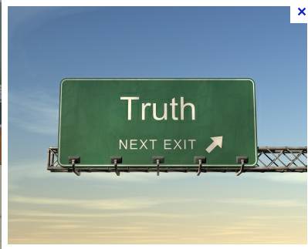
What are the elements of a proper argument?
A fully formed arguments makes a statement of possible truth , then

Slide 14
What are the elements of a proper argument?
Gives support for that argument in terms of some reason why this argument is true, and
Its logical!

Slide 15
What are the elements of a proper argument?
Explicitly explains the importance of this argument in terms of how the argument proves the position true or how the implications of the argument affects people. In other words, Tell us we should care.

Slide 16
How arguments are warranted
Analytical warrants – it logical!
Empirical warrants – here are examples that collectively prove the general point
Psychological warrants – here is why people tend to act this way.

