Slide 1
Judge Adaptation
“This is my first time Judging…”

Slide 2

What is judge adaptation?
Judge adaptation is the method of changing your in-round strategy based upon who is judging your debate.
This can range from the types of arguments you run, to the speed that you read them, to the method of your rebuttals.
Judge adaptation can literally change everything about how you debate.

Slide 3
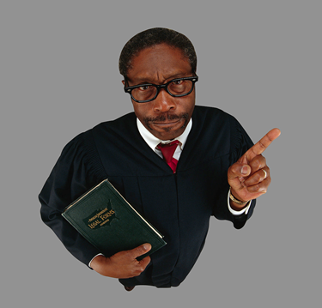
Why does it matter?
Would your mom understand a conversation about debate?
Many of your judges will be parents or volunteers with little to no debate experience.
Some judges know debate, but are very particular about what they see in rounds.
The Judge is God.

Slide 4
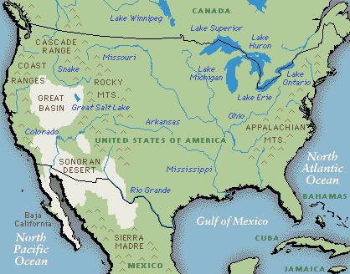
Where is this useful?
Judge adaptation is an important skill at any tournament.
No two judges are the same, meaning that being able to adapt to what each judge wants is always helpful.
Even at the highest or lowest level tournaments, you will need to adapt to judges.
Paradigms or parents

Slide 5
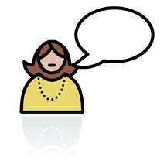
Lay Judges
Lay judges know little to nothing about speech and debate.
Lots of people don’t like lay judges, but they can really be lots of fun.
You’re no longer a debater. You’re a speaker: A speaker speaking to small children.
What’s a flow?

Slide 6
Flow Judges
Flow judges know what they are doing and will judge the round almost completely based upon the arguments made.
But that doesn’t mean every flow judge is the same.
There are primarily two types of flow judges- Progressive flow judges and traditional flow judges.

Slide 7
Traditional Judges
Traditional judges care more about the value, value criterion, philosophy, and good speaking skills
Don’t fall for the trap that they’re stupid and don’t understand debate. They just have more preferences for reasonability.
To adapt to a traditional judge, no crazy arguments, no crazy speed, always emphasize framework, and always stay polite.
You will still debate based on the arguments and the
flow.

Slide 8
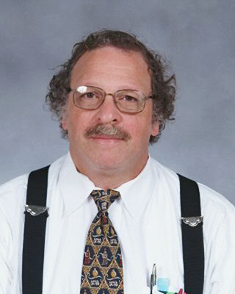
Traditional Judges
Some traditional judges aren’t even flow judges. They might judge the round completely based on speaking.
These are the rounds that you will abandon the flow and sound pretty like for a lay judge.
Traditional judges are normally older. They could
easily be a man or woman. Coaches are often very
traditional.
They will generally be more proper about the event
and may say they will allow any arguments, but
prefer a more traditional debate.
I prefer a value debate!

Slide 9
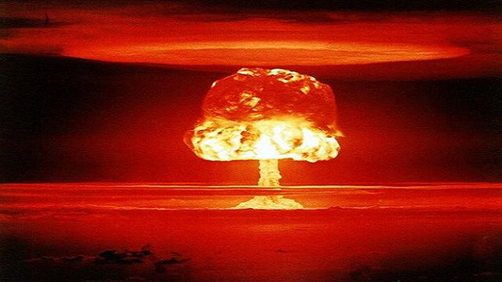
Progressive Judges
Progressive judges will buy many different types of arguments and styles of arguing.
They are okay with speed, kritiks, DAs, counterplans, anything really. They can be open to any argument or style of debate.
To adapt to a progressive judge, realize that they will vote on most arguments, so don’t underestimate anything your opponent is running, and be ready to broaden what you may be willing to run.

Slide 10
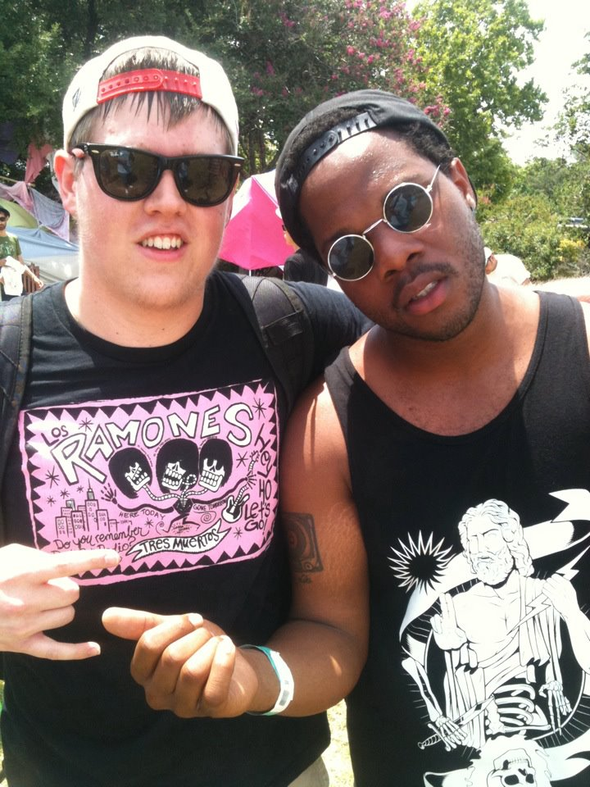
Flay Judges
Flay judges have debate experience. They think they are great flow judges. They AREN’T.
A flay judge might call for cards, only flow parts of your arguments, and will likely be very young.
Be really confident, flashy, and emphatic. Persuasion and a bit of deception are critical for flay judges.
A flay judge will be overly relaxed, very
braggy or pretentious, like to talk a lot
about debate. They’ll make lots of jokes
poking fun at you or the event.
Generally college student guys who
think they’re really cool.
UH is a big red flag
I only flow tags!

Slide 11
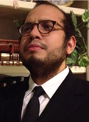

Progressive Flow Judges
Progressive flow judges will buy many arguments and be able to keep up with them very well.
Often the favorite judges of high level debaters.
Many are young people who are former debaters, but they can look like anything. Their behavior is most important. They will normally be very relaxed in the round, but not overly
joking or pretentious.
They will flow everything.
A progressive judge will typically allow
any argument, so your execution and skills are what
will matter most.
As long as you can justify it…

Slide 12
CX judges

Slide 13
PF JUdges

Slide 14
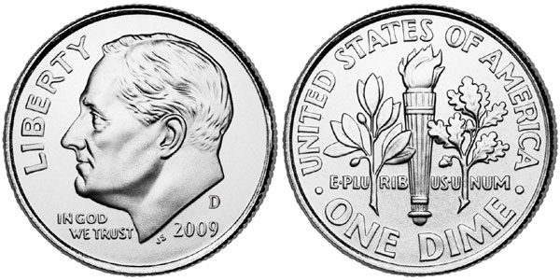
Paradigms
Paradigms are a judge’s preferences for the debate round.
Asking about paradigms is helpful for you to formulate you strategy for the round.
“Do you have any preferences for the debate?”
“Do you have any specific questions?”

