Slide 1
Debate Research

Slide 2
Useful Extensions and Services

Slide 3
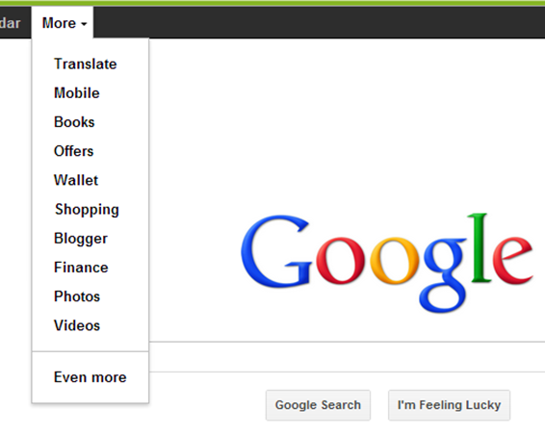
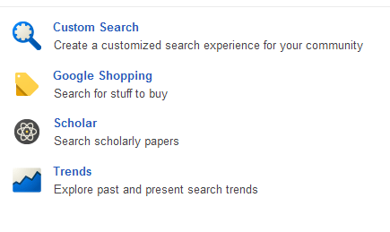

Slide 4
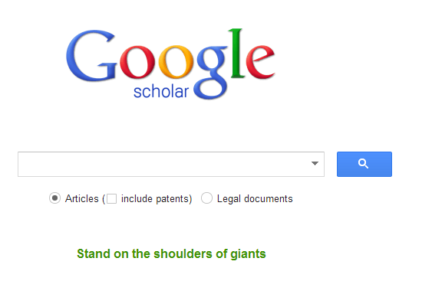
NOT Google, but ….
Advanced
Search
Button

Slide 5
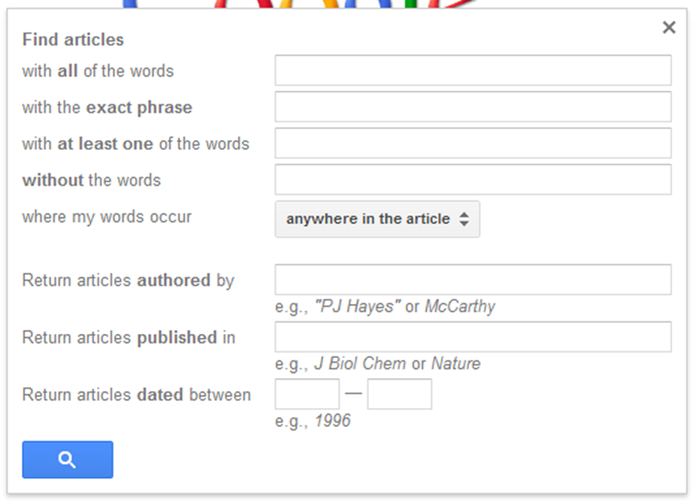
Advanced Search In GS

Slide 6
What to Search for?
It goes back to your topic analysis/brainstorm notes
“What comes to mind when you think about X?”
X is a term of phrase from the resolution.
Keep a list of responses.
When you have finished, go back over the list and star the ones that look useful.
These are the terms you will use to begin your research.

Slide 7
What do I do first?
Read a general overview
Wikipedia is a good place to start, but DON’T quote in round.
Little note taking/ card cutting at this stage.
Add new terms, key phrases to your list from the brainstorming sessions.
Try to find 2 or 3 key articles you can use in writing your case, but DON’T get roped into anything at this stage. Keep your options open.

Slide 8
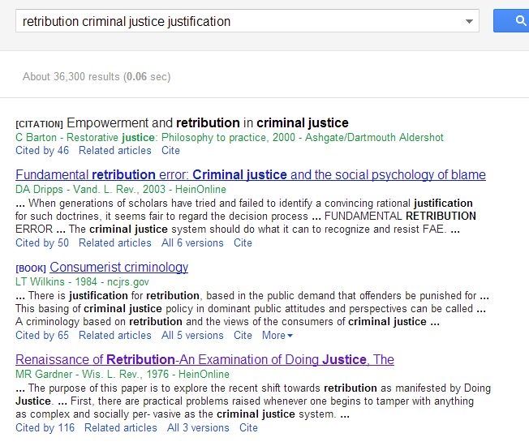
Key words/Choosing an article

Slide 9
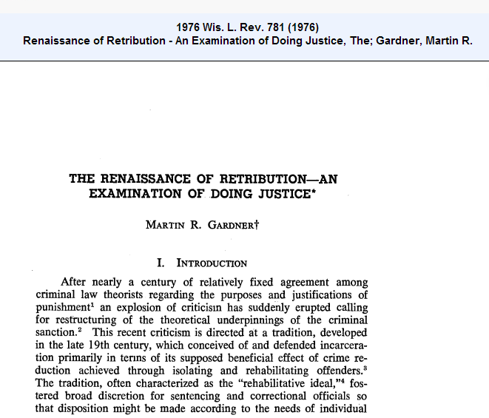
The Article and what to notice

Slide 10
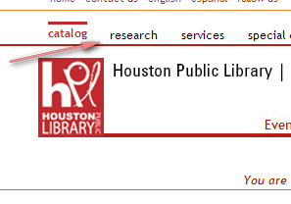
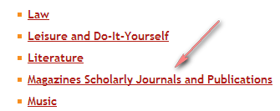
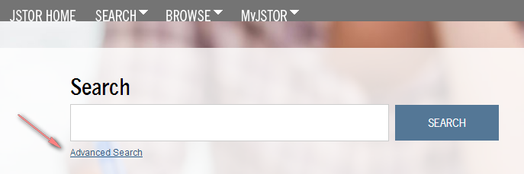
The Houston Public Library
http://www.houstonlibrary.org/librarycard
http://www.houstonlibrary.org/services

Slide 11
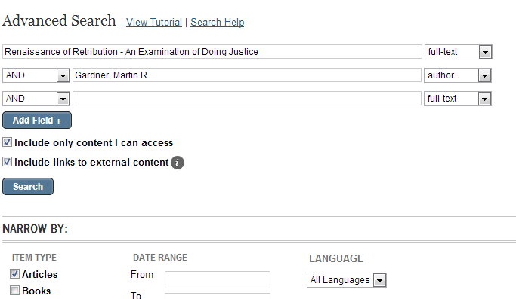
Jstor advanced search

Slide 12
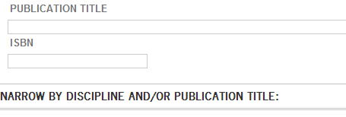
Another Search Narrowing Feasture

Slide 13
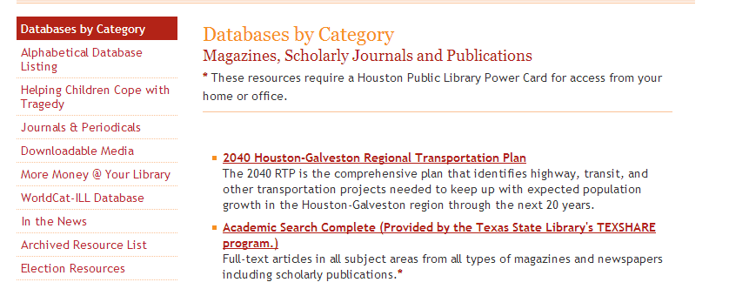
Access to other Academic Sources
http://www.houstonlibrary.org/research

Slide 14
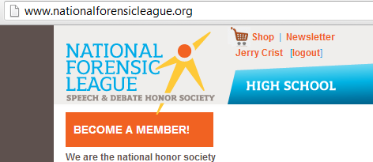
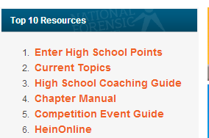
If your are signed up with the NFL…

Slide 15
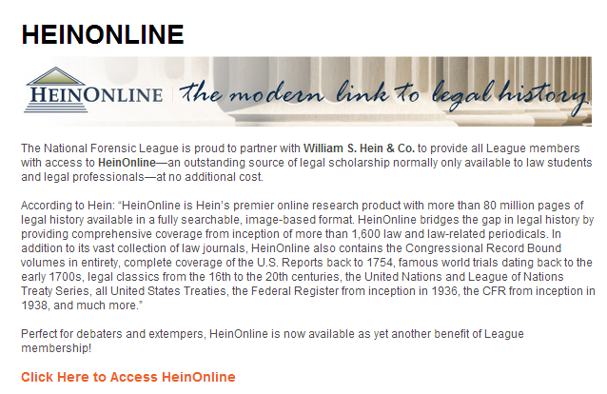
Getting Linked Up…

Slide 16
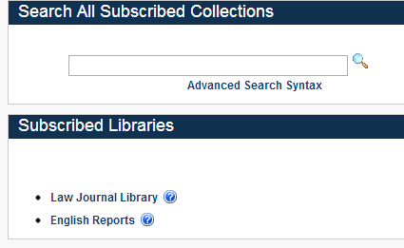

Slide 17
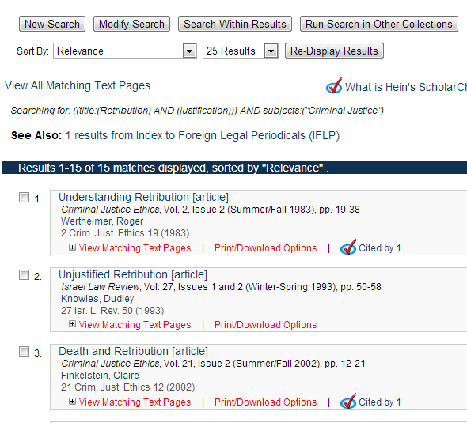
A sample result

Slide 18
Assignment
Run down this article and be able to tell me about the abstract (summary)
“Just Say No to Retribution” [article]
Buffalo Criminal Law Review, Vol. 7, Issue 1 (2003), pp. 17-84
Rubin, Edward
7 Buff. Crim. L. Rev. 17 (2003-2004)
ALSO, work with a partner or alone and find a new Negative article using the new resources form this lecture….
http://nolimitsdebate.weebly.com/search-this-site-and-research-page.html

