Slide 1
What is LD Debate?

Slide 2
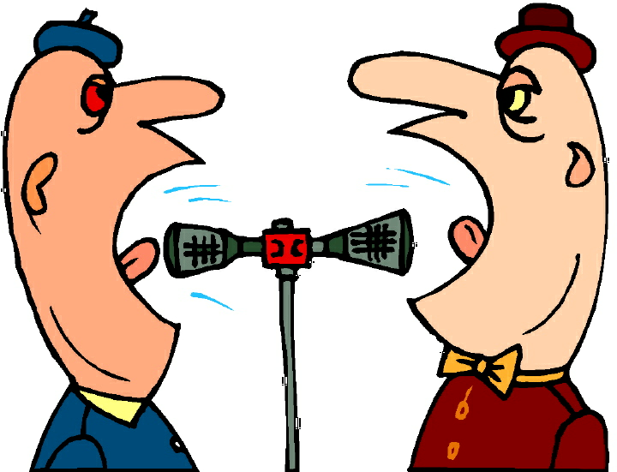
First it is Debate
But NOT THIS !

Slide 3
Policy Resolutions
Its about the plan – advantages/disadvantages/solving a problem
Example: Resolved: The United States Federal Government should substantially increase its democracy assistance for one or more of the following: Bahrain, Egypt, Libya, Syria, Tunisia, Yemen.

Slide 4
Public Forum Resolution
Resolved: Stand Your Ground laws are a legitimate expansion of the doctrine of self defense.

Slide 5
LD Resolutions
A government has the obligation to lessen the economic gap between its rich and poor citizens

Slide 6
The Organization of an LD Round
Affirmative Constructive- [4:50] 6 minutes
Negative Cross Examination of Affirmative- [ 9:50] 3 minutes
Negative Constructive- 7 minutes
Affirmative Cross Examination of Negative- 3 minutes
First Affirmative Rebuttal- [28:45] 4 minutes
Negative Rebuttal- 6 minutes
Second Affirmative Rebuttal- 3 minutes
Throughout the debate, each speaker will have a specified amount of preparation time, usually 4 minutes.

Slide 7
how an ld case is organized
1. Opening
2. statement of the resolution
3. Value
4. Value Criterion (standard)
5. Definitions
6. (Optional) observations
7. Contentions and subpoints
8. Closing

Slide 8
What is an argument in Formal Debate?
Starting with an example performance:
Resolved: Students should not be allowed to bring their cel phones to school.
Three good arguments for this would be?
Three good arguments against this would be?

Slide 9
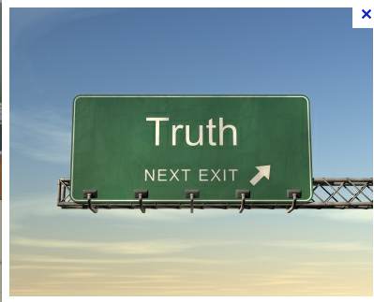
What are the elements of a proper argument?
Each of the fully formed arguments we developed :
Makes a statement of possible truth , then

Slide 10
What are the elements of a proper argument?
Gives support for that argument in terms of some reason why this argument is true, and
Its logical!

Slide 11
What are the elements of a proper argument?
Explicitly explains the importance of this argument in terms of how the argument proves the position true or how the implications of the argument affects people.

Slide 12
How arguments are warranted
Analytical warrants – it logical!
Empirical warrants – here are examples that collectively prove the general point
Psychological warrants – here is why people tend to act this way.

Slide 13
Jumping in: The Demo round and flowing
What is flowing?
Strongly suggested follow up – Go to the class website here:
http://nfltv.org/2010/03/15/learning-ld-debate/
Specifically look at their Demo Debate. It will reinforce things we talked about and offer other basic ideas and techniques

