Slide 1
What do I do in the ______ speech?

Slide 2
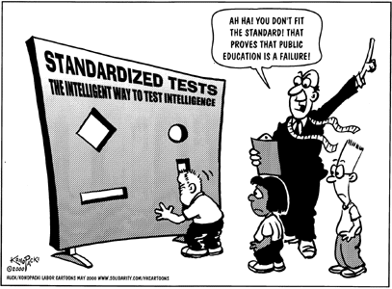
PF Resolutions
On balance, standardized testing is beneficial to K-12 education in the United States

Slide 3
The Organization of an PF Round Constructives
Teams flip for who speaks first, AFF or NEG
Team 1 Constructive (delivered by 1st speaker of team): 4:00 minutes
I advise opening with an attention getter – a powerful quotation or observation ;because I believe that “In this the richest country in the world, No one should die because they cannot afford basic healthcare. I affirm the resolution “The US Government should provide fundamental healthcare as a fully funded right for all citizens”
Proceed with the rest of your constructive.
Team 2 will follow with their constructive.

Slide 4
The Organization of an PF Round 1st Crossfire
First speakers question each other
Crossfire gives you an opportunity to expose weaknesses in your opponents’ case. Use it. No pointless questions.
You might want to have some questions prepared in advance which are based on your case’s strong points.
See the suggestions in the what is PF PPP.
We will have a separative presentation on some special strategies in CF.

Slide 5
Rebuttals – 4 steps
Locate the argument you wish to answer.
[ A good “flow” is key, We will be working on flowing throughout the camp ]
Summarize the argument to which you are responding
The trick is to summarize it in the most you-benefical way possible. This means choose your works carefully and slantedly
Respond to the argument.[ Why is the argument not true or sufficient ? We have a separate presentation on this as well.
Explain the impact.
As with any argument, tell the judge why he or she should care.

Slide 6
Organization of a PF round - 2
Team 1 Summary (delivered by 1st speaker of team 1 ) 2:00 minutes
Team 2 Summary (delivered by 1st speaker of team 2 to refute opponents point but mainly to protect their own): 2:00 minutes
Grand crossfire (everyone is involved asking questions to anyone): 3:00 minutes
Team 1 Final Focus (delivered by 2nd speaker of team 1 ): 2:00 minutes
Team 2 Final Focus (delivered by 2nd speaker of team 2 ): 2:00 minutes
Each team has 2 minutes of prep time to be used anytime in the round. You do not have to use this all at once.

Slide 7
Crossfire 2
Same key concerns as CF #1. BUT the debate has progressed. Pay attention to the key points you may be winning, that have emerged as weaknesses in their case. Hit these hard.

Slide 8
Summaries
3 minutes to help the judge cut through all the confusion of a complex round.
Judges may be asked to consider as many as 20 or 30 distinct arguments, each with several responses or challenges attached, and all in some form of conflict with one another
Chose which arguments you will go for by asking yourself some questions.

Slide 9
Grand crossfire
See the notes on Crossfire. Same tactics , except this time you should know exactly what weaknesses to go for with your questions.

Slide 10
Summaries
Quantity of debate. Which arguments have produced the most clash and responses?
How connected is the argument is to the other issues of the round? Crystallization time is generally better spent on issues that are connected to and interact with many other issues.
Strategy : What arguments that are you most clearly winning or give you the best chance to win. This makes you look sharp and in most cases lead you to engage the key issues the judge is thinking about.

Slide 11
Final Focus
You only have 2 minutes, so DON’T WASTE SUMMARIZING EVERYTHING THAT HAS HAPPENED.
Choose the key argument that you have won , explain why it is the most important one in the round and why it overrides anything else in the round.

Slide 12
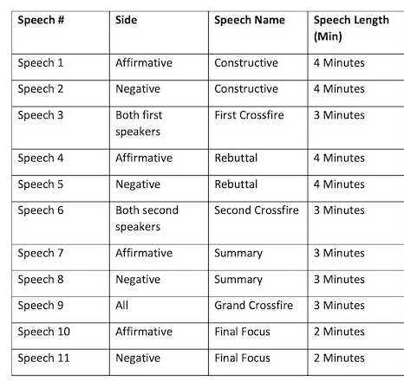
Times and Speeches

