Slide 2
Persuasion: The KEY to Successful Debate
An introduction

Slide 3
What is Persuasion?
Persuasion is a process.
Persuasion is an attempt to influence another .
Persuasion prepares people to change or form their own views .
Persuasion happens through the transmission of a message.
Persuasion requires free choice

Slide 4
What is Persuasion? 2
Persuasion is a process
step by step

Slide 5
What is Persuasion? 3
Persuasion is an attempt to influence another
is a crying baby a Persuader?

Slide 6
What is Persuasion? 4
Persuasion prepares people to change or form their own views ?
force anybody lately?

Slide 7
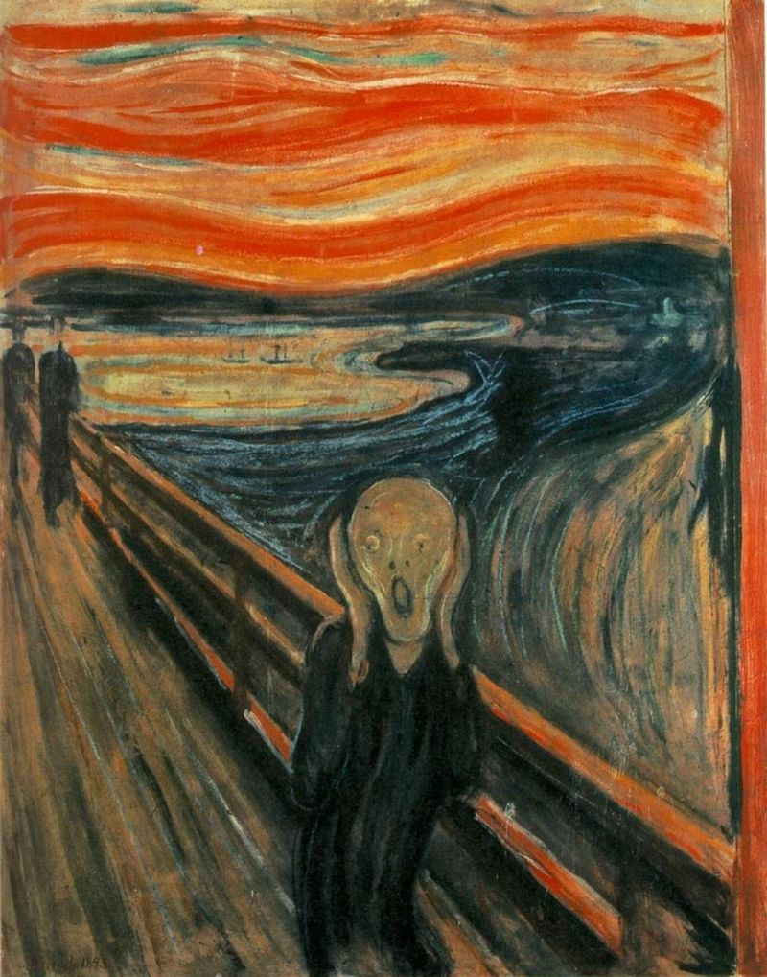
What is Persuasion? 4
Persuasion happens through the transmission of a message.
is art persuasion?

Slide 8
What is Persuasion? 5
Persuasion requires free choice
Can you persuade a zombie? a Trump supporter?

Slide 9
In a moment....
We will have several of you try to persuade us.
You will ask you to do this:
1. record at the top of a page of your notebook how you feel about the topic before the speaker starts
2. When the speaker finishes record your opinion
3. Try to figure out the tactics the speaker used in their efforts at persuasion
For example - appeals to logic, name-calling, name dropping, emotional appeals, pretty words, examples, appeals to guilt, etc.
What was their best tactic? which was worst? why?

Slide 10
A Practical Experiment
In about 10 minutes, I will pick , at random 4 people to “persuade” on one of these topics, their choice. They will have 5 minutes. You may work in teams of 2 to prepare
Donald Trump will make a great president
Mom, you should let me use the car Saturday for my big date
Students who learn how to debate are the coolest kids!
Only the strong survive - we shouldn’t try and help the weak.

Slide 11
Break into small groups of 8 or so
In your small group discuss your answers to the questions I posed.
Have someone take notes on what is said.
Is their a consensus on the strongest and weakest tactics?
What percentage of those present had their views changed? Why this outcome?

Slide 12
Part 2: What the Experts Say About Persuasion

Slide 13
The Big Three
Ethos
Make them like you/ or at least find you likable
Pathos
Make them feel with you
Logos
Make them see reason
Which of these do you think is the most important/comes first?

Slide 14
An Example
https://www.amazon.com/Verdict-Paul-Newman/dp/B000SW4DOO/ref=sr_1_1?s=instant-video&ie=UTF8&qid=1465478164&sr=1-1&keywords=the+verdict

Slide 15
Ethos
Know topic , be able to talk about it smoothly and smartly.
Project confidence - fake it till you make it

Slide 16
Pathos
When used well, pathos moves the audience to feel the same things as the speaker
anger , fear, outrage, pity,
builds a bond with the listener

Slide 17
Logos
Logic, reason, evidence, data
Two general kinds:
Deductive arguments
Inductive

Slide 18
Deduction
Deductive arguments are based on premises, if these premises are true then the conclusion must be true. For example:
* All humans die (premise)
* Kevin is a human (premise)
* Kevin will die (conclusion)

Slide 19
Induction
Inductive reasoning is less certain. It works from specific to general and its outcome is probable:
* Kevin has voted against the bill every time (premise)
* The bill is up for a vote again (premise)
* Kevin will probably vote no again (conclusion)

Slide 20
Telling the Story
Have a thesis/ have a narrative
Five Key Questions
What is the problem?
Who is the villain causing the problem?
Who is the victim?
Who is the hero?
What is the common sense solution?

Slide 21
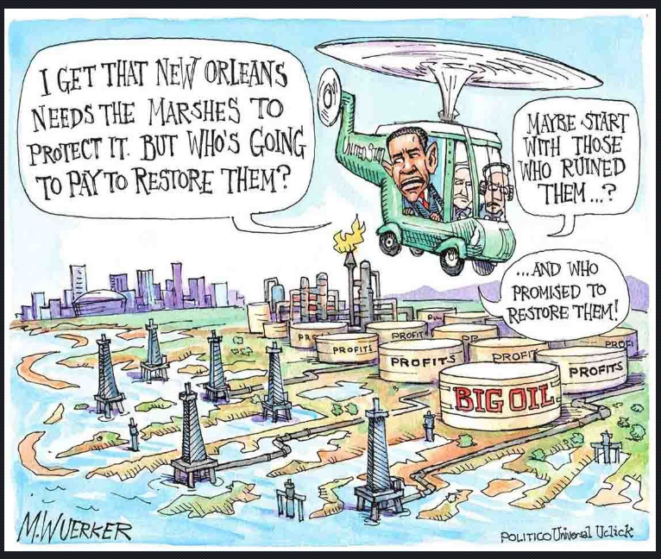
Try it out

Slide 22
Finally, The VOICE!
Use it - we will be working on that next in small groups
Tone
Volume
Voice Inflection
Enunciation
Mannerisms
Speed
Contrast

