Slide 1
Case Structures
What a debate case looks like…

Slide 2
Your case is….
Your position on the resolution
A narrative that has a simple thesis which “frames” the round
A narrative is your story –
Standardized tests are used to punish public schools , not to equalize educational opportunities.
In every narrative …
There is a problem
There is a hero
There is a villain
Who is the victim
There is a common sense solution

Slide 3
An opening
Opening Statement
-typically a one sentence statement
-Establishes a most important “value” for the round i.e. national security, the environment etc..

Slide 4
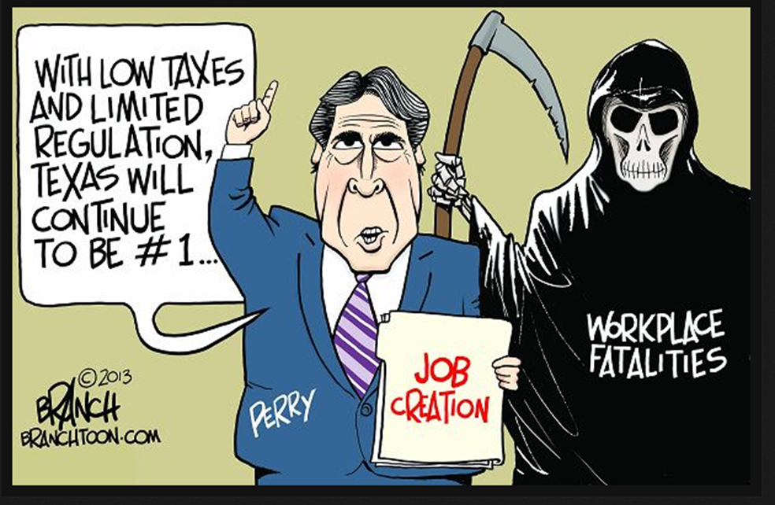
Framing tells the judge how to think about the round…
What is the problem? Who is the villain? Who is the hero?
Who is the victim ? What is the common sense solution?

Slide 5
Opening Statement
-typically a one sentence statement
-Establishes a most important “value” for the round i.e. national security, the environment etc..
In POFO, we don’t call it a value,but is serves the same purpose.
For example: Government spying kills democracy by destroying our trust in each other and in our government.

Slide 6
Definitions
-Key definitions are read next
during the first speech additionally possible contentious definitions should be included but not necessarily read in the speech
-These allow you to shape the round by determining what words mean
-Smart use of definitions can allow you to expand your offense or prohibit opponents from gaining access to theirs

Slide 7
Observations
-frame the debate
-determine what constitutes ground
-establish weighing mechanisms

Slide 8
Contentions
This is the meat and potatoes for your case
Should be full sentences, power worded:
Poor: Standardized tests are disruptive of classroom best practice.
Better: High stakes testing is a disaster for at risk students
-The reasons as to why the judge should vote for you
-May contain sub points, but be careful about having too many

Slide 9
About the structure of contentions
Claim
Warrant
Impact

Slide 10
Closing Statement
Save some time at the end to repeat your thesis and summarize your position, referencing your contentions-
End with a statement asking the judge to vote for you i.e. Thus we urge a negative/affirmative ballot

