Slide 1
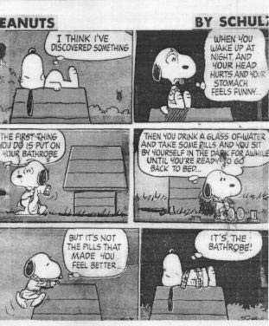
Attacking and Defending Statistical Evidence
Figures don’t lie, but lairs figure!
Then there is the man who drowned in a stream with an average depth of six inches.

Slide 2
Correlation and Causation

Slide 3
Storks and Babies

Slide 4
“Three men are in a bar. Each man earns $50,000.
The average = per capita income in that bar is $50,000 .
^{In walks Bill Gates.}

Slide 5
The Bill Gates Story
The average income now is several million dollars.
Notice that the 3 men are not any richer.
The new average is a misleading statistic – true enough, but irrelevant to the situation of the 3 original barflies. “
A median of the incomes would be more accurate.
The MEAN is the arithmetic average, the average you are probably used to finding for a set of numbers - add up the numbers and divide by how many there are: (80 + 90 + 90 + 100 + 85 + 90) / 6 = 89 1/6.
The MEDIAN is the number in the middle. In order to find the median, you have to put the values in order from lowest to highest, then find the number that is exactly

Slide 6
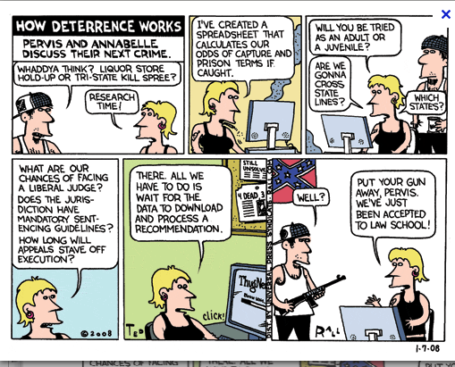
Using unrepresentative sample sizes
In the debate about the death penalty, there was a marvelous card summarizing a study which purported to show that for every execution, there were 5 or so less murders in the following reporting periods.

Slide 7
Using unrepresentative sample sizes
The mathematics were sound, but the study was not.
Upon digging into the details of the survey, it turned out that there were very few jurisdictions carrying out executions, so there were very cases of executions followed by drops in murder rates. In fact, the studies conclusions were bases on 11 cases

Slide 8
Selective Time Frame
The survey arbitrarily selects a time frame which proves the conclusion they were seeking to prove.

Slide 9
Selective Time Frame
^{Debate example:}
In the debate over the effects of laissez-faire economic policies (trickle down/ supply side policies) on economic growth. You draw examples from the period 1980-1985. It turns out that the economic downside of such policies did not become evident until after this time frame.

Slide 10
One or Many?

Slide 11
Many Or One?
^{Poverty causes crime.}
Most social phenomena have multiple complex causes. If you argue that only one cause is responsible for the phenomena, you are guilty of the single cause error.
Without some story about causation this is simply the “correlation-causation” problem. With evidence, we have the problem of single causation. No everybody living in poverty turns to crime, so the burden is on the person presenting this claim to demonstrate how much of crime is caused by poverty, whether poverty is a primary cause or a secondary one, etc.

Slide 12
Suspicious/Inflated Data

Slide 13
Suspicious/Inflated Data
Flanked by Attorney General Alberto R. Gonzales, Bush said that "federal terrorism investigations have resulted in charges against more than 400 suspects, and more than half of those charged have been convicted.
An analysis of the Justice Department's own list of terrorism prosecutions by The Washington Post shows that 39 people -- not 200, as officials have implied -- were convicted of crimes related to terrorism or national security.
Most of the others were convicted of relatively minor crimes such as making false statements and violating immigration law -- and had nothing to do with terrorism, the analysis shows. For the entire list, the median sentence was just 11 months.

Slide 14
Apples and Oranges
Frank Luntz on Fox News this morning: All the statistics that I've been testing on both sides, this one stands out: the increase in discretionary non-defense spending over the past four years is 80%. Does any family within the sound of my voice have an 80% increase in spending?
[april 2011]
How many families have a budget in the trillions, are responsible for keeping the whole economy going in a recession and paying the unemployed their unemployment insurance during a recession and the list goes on and on.
How many families cope with an economic downturn (unemployment , etc.) by throwing grandma out , starving the kids, letting illnesses go untreated, getting rid of the dog or putting him to sleep etc.?

Slide 15
The Amazing Unqualified Stat
500 million people have been lifted from poverty largely as a result of freer trade and market reforms.
How was this number arrived at?
^{Was China part of the study?}
How much did free trade contribute to this outcome? How much did market reforms contribute? What kind of market reforms?
Are we talking about absolute poverty or relative poverty? Did these people simply become working class or middle class or simply working poor?
If relative poverty, were the poor more able to take part in the life of the larger society? Protect themselves politically as a consequence of their increased status?
What about the quality of life?
Were women and children required now to work full time to produce this outcome?
Did this growth produce a path to education and healthcare and other necessities for upward opportunities?

Slide 16
Apples and Oranges 2
Anyway, this particular senator has been a steadfast critic of public schools, calling us inefficient and creating layer upon layer of bureaucracy to watch over us and micromanage everything we do. This session she has often repeated a dubious statistic about the "1-to-1 ratio" of teachers to non-teachers in Texas schools, and how that ratio was 4-to-1 back in the 1970s--never mind the fact that
a.) the state's statistics in the 1970s didn't include lunch ladies, bus drivers, and other non-teachers, creating a false comparison, and
b.) the amount of bureaucratic nonsense and inflexible accountability measures piled on Texas schools beginning in the 1980s has created countless man hours of reporting and testing paperwork and has led schools to hire testing coordinators, math coaches, parent involvement coordinators, etc.
When this senator implies that the state of Texas is broke because superintendents like me just go wild hiring unnecessary non-teachers, it feels very much like I'm being slapped for doing what the senators forced me to do. I feel like public school officials are the Official Scapegoat of Texas.
http://blogs.edweek.org/teachers/living-in-dialogue/2011/03/i_am_educator_hear_me_roar_an.html

Slide 17
Responding to statistical evidence
Just because a statement includes numbers or is based upon a statistical study does not mean that it is true.
Many statistics are not based upon actual count
For example counts of the number of homeless people are often draw from incomplete and questionable data.
Even the unemployment statistics are projections based upon sampling techniques
Even experts disagree on how to sample a statistical universe and over how to interpret what they find.

Slide 18
BEST Studies are Meta-Studies
Summaries of scholarly studies on the same topic, analyzed by another scholar
Know the methodology , the credentials of the authors, the sample size and how the sample was selected.
DON’T over claim the results!

Slide 19
Stats as Argument by Example
Example
Arguments by example make a generalization about a class based upon an examination of limited numbers of that class. There are three common test argument by example.
1) Are the examples typical of the of the class.
2) Are there sufficient number of cases.
3) Are negative instances accounted for?

Slide 20
More Stats for Analysis
Wage Growth:
Average hourly compensation has risen by 3.9% over the past year, while average weekly earnings have growth 4.6%.
The Republican Playbook does not adjust for inflation. Here are the inflation-adjusted numbers.
According to the National Bureau of Economic Analysis, this expansion started in November 2001 when according to the Bureau of Labor Statistic the average hourly pay of non-supervisory workers was $14.70. This figure was $16.62 in May of 2006 for an increase of 13.06%. Over the same period, the inflation gage according to the Bureau of Labor Statistics increased from 177.4 to 202.5, or an increase of 14.15%. Therefore, wages for non-supervisory employees have decreased a little over 1% since this expansion began.
However, the unemployment rate dropped below 5% in December 2005, signaling "full employment". Has the decrease in labor supply increased wages? No. In December 2005 the average hourly wage of non-supervisory employees was $16.35. In May that number was $16.62 for an increase of 1.65%. Over the same period, the overall inflation measure increased from 196.8 to 202.5 or an increase of 2.89%. Therefore, since the economy hit "full employment" wages have decreased 1.25%.

Slide 21
Attacking Stats 1
There are 4 suggestions on what to look for it in statistical studies.
Look for the original research report and study it.
Those who use research report often put their own spin on the results.
Finding copies of original research reports requires special effort.
Consult footnotes in articles or books.
Consult government agencies or congressional committees.
Consult Social Science Citation Index.
One can even try contacting the author of the report by e-mail or snail mail

Slide 22
Attacking Stats 2
The original research report contains a section on methodology and one on interpretation or conclusions.
In both sections one can find reservations about the meaning and scope of the study
The section on conclusions or interpretations is often the most fruitful place for attacking a study. Here one finds inferences and value judgments .
Sampling technique should be thoroughly examined.
Since most statistical findings are based on studies of limited population the selection of the sample population is critically important.
The same arguments one uses for evidence by example can be applied to these studies.

